Slide 1
INFO6003 Lab-08
Gihan Shamike Liyanage
1142109

Slide 2
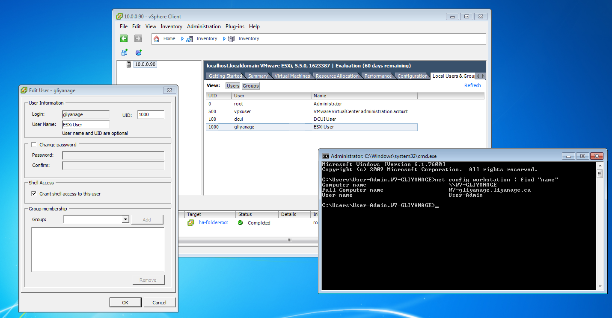
Slide #1

Slide 3
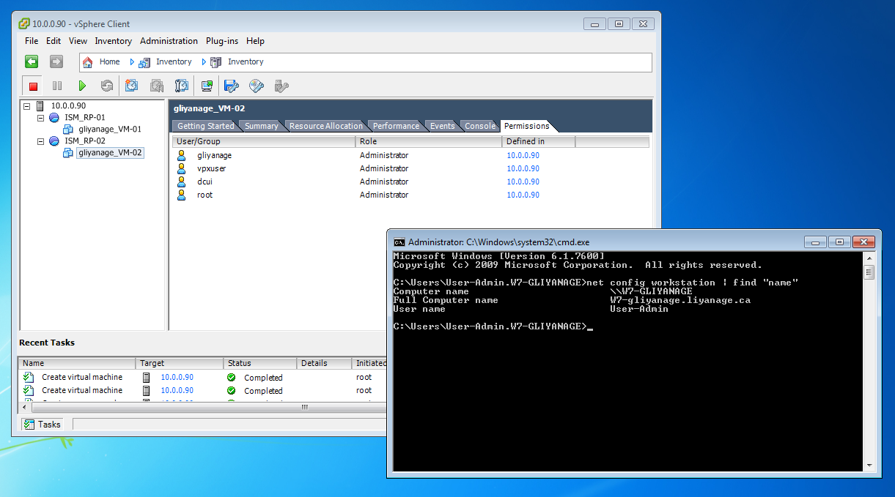
Slide #2

Slide 4
Right click in the white space and try to assign another permission to this VM.
Why did this fail?
Because in the previous step we removed administrator privileges and assigned Power State role to this user for FOLusername_VM-01.

Slide 5
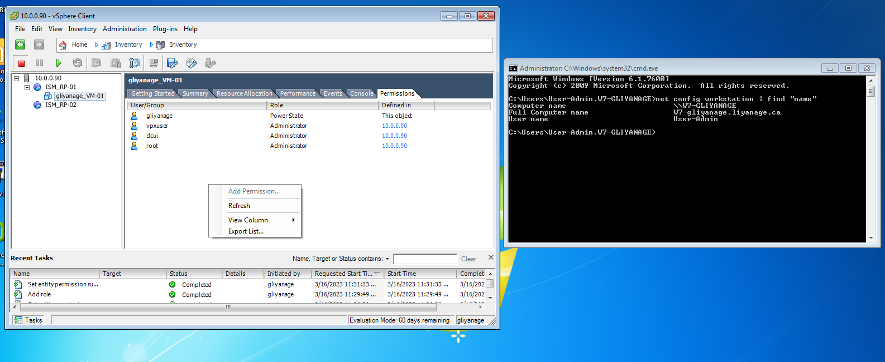
Slide #3

Slide 6
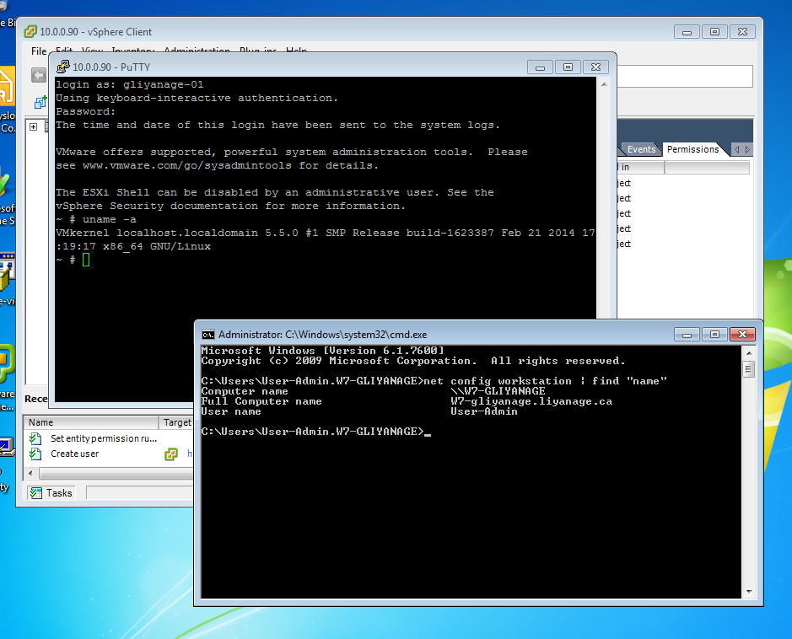
Slide #4

Slide 7
Slide #5

Slide 8
Slide #6

Slide 9
Slide #7

Slide 10
Slide #8

Slide 11
Slide #9

Slide 12
Slide #10

